Slide 1
Recitation 8
Greg, Will, Sheil

Slide 2
Car design archetypes
Differential Drive/Dubin’s Car/(2 motors + casters)
One versus two casters
Holonomic Drive
Tank Drive

Slide 3
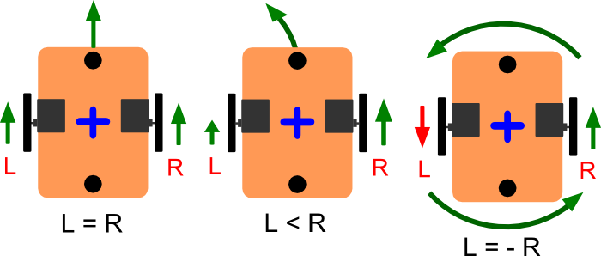
2 Motors + casters
Car dynamics:
Group 4
Single Caster
Need to account for weight distribution
Too much load on casters may cause motors to slip
Two Casters
Difficult to ensure wheels and both caster are level

Slide 4
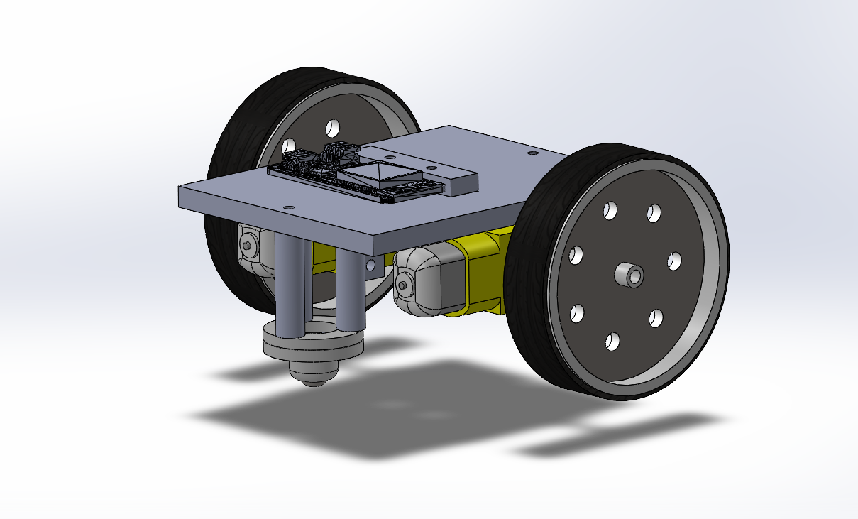
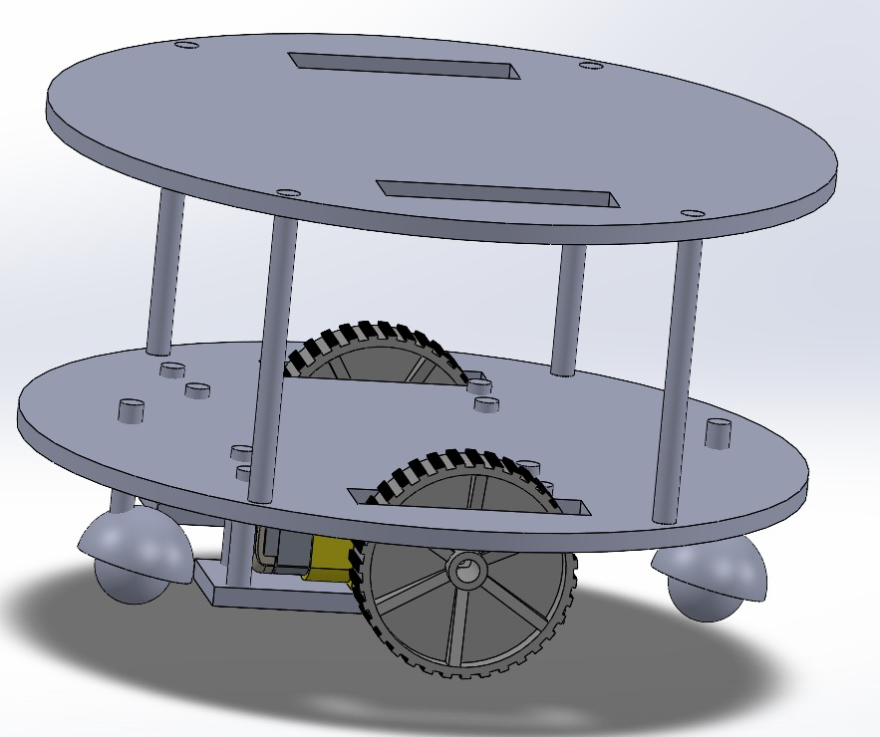
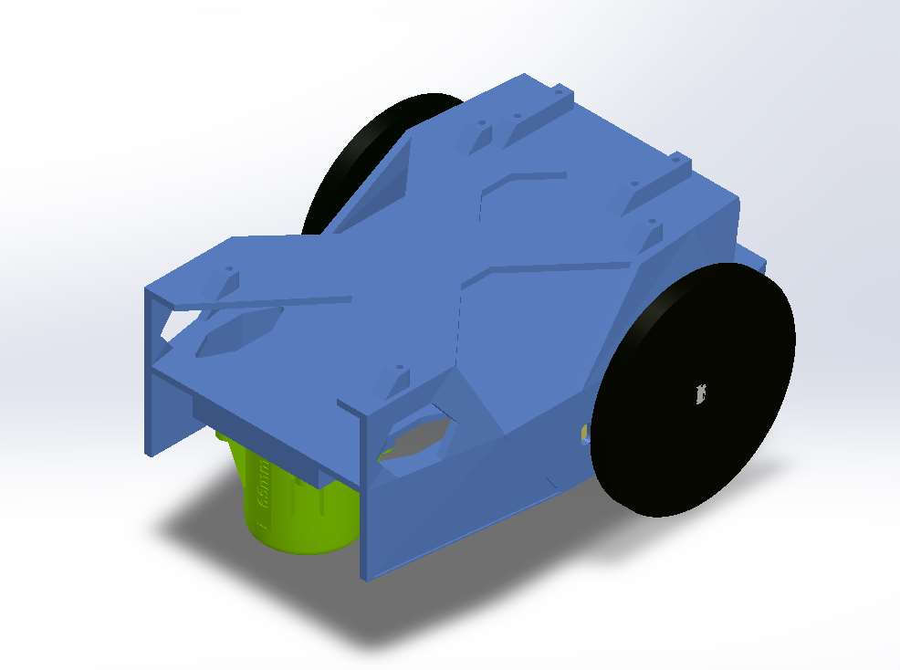
2 Motors + casters
Single Caster
Two Casters
Group 26
Group 13
Group 25

Slide 5
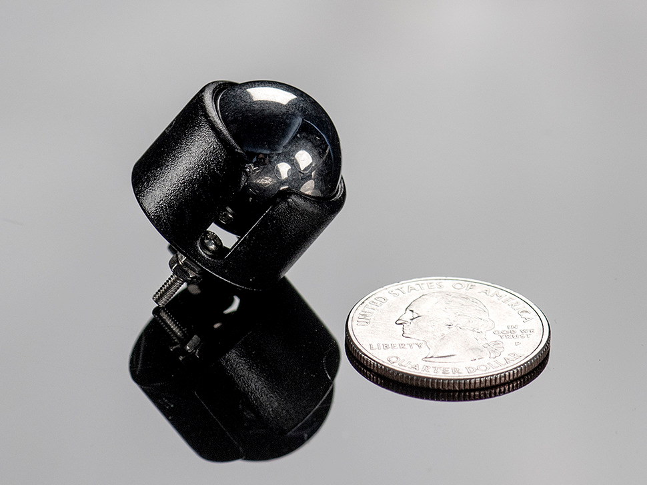
Caster options
Passive Sliding
3D printed dome
Laser cutting not recommended due to edges getting caught on seams of the competition environment
Ball Caster
Make sure ball is large enough to not get caught on edges/gaps
https://www.adafruit.com/product/1200

Slide 6
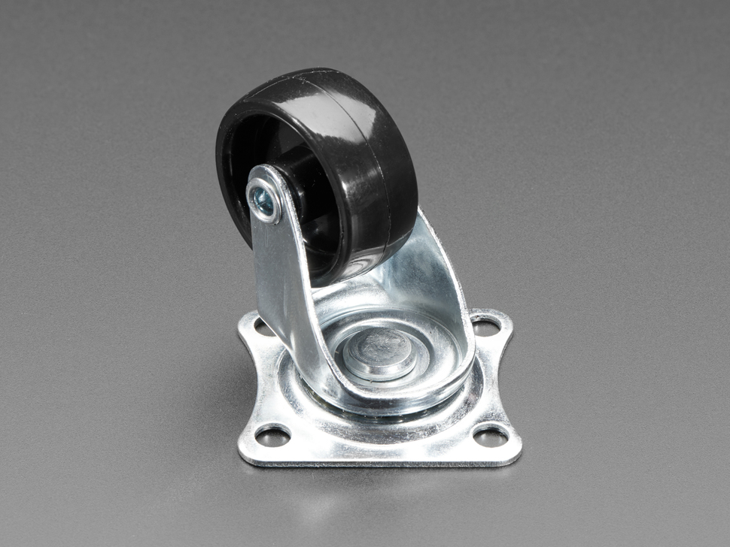
Caster options
Caster Wheels:
Generally larger than caster balls
Needs to swivel before rolling
https://www.adafruit.com/product/2942

Slide 7
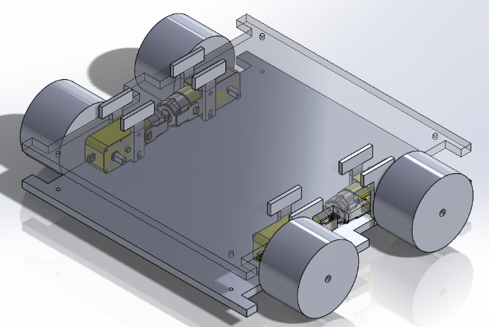
Differential Drive (4 Motors)
Pros:
Higher power (speed/torque) from 4 motors
No balance/weight distribution issue
Cons:
Need to ensure consistency between motor speeds
Needs to have the correct wheels for turning (wheels slide horizontally during turns)
Make sure to test this early!
Group 27

Slide 8
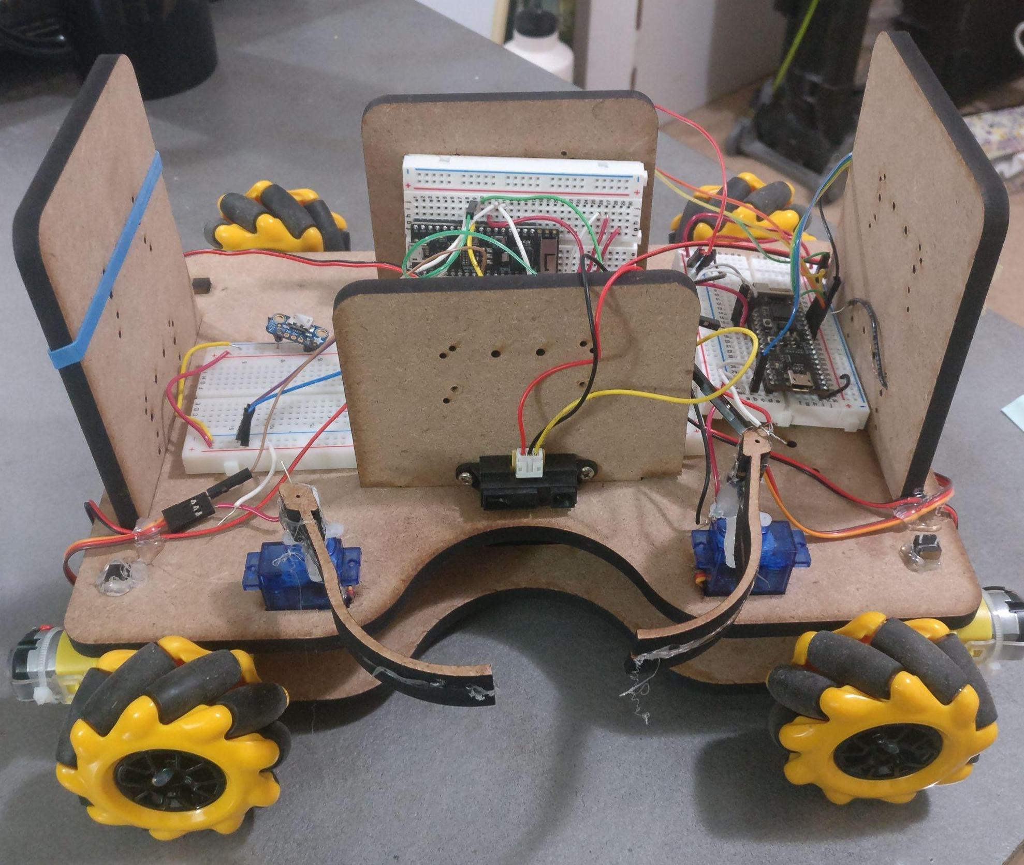
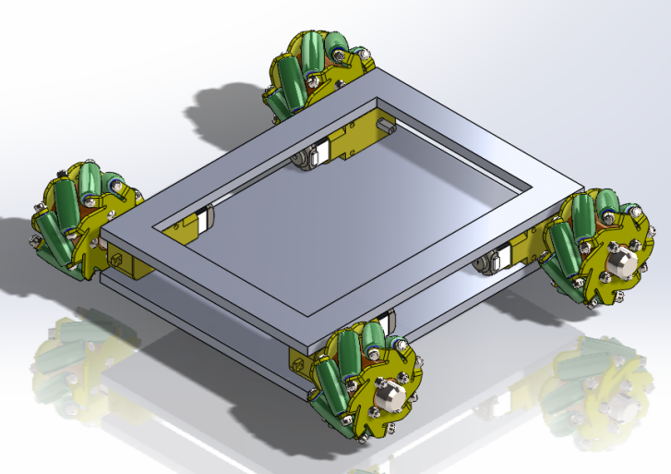
Holonomic Drive: 4x Mecanum Wheels
Pros:
No turning required in rectangular loop
Very stable, can carry more load
Programmable Behavior: Joystick style controller + Rotate CW and CCW

Slide 9
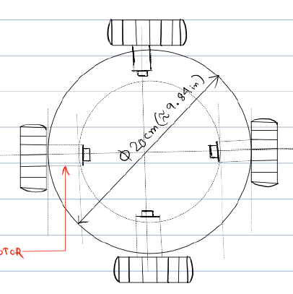
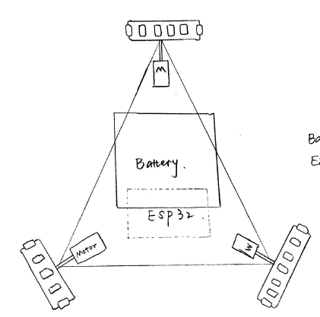
Holonomic Drive: 4x Mecanum Wheels
Other Holonomic Drives:
Cons:
Using 4 motors without a feedback loop can lead to drift, which compounds over time; hard to maintain straight heading
Cost: 4x Mecanum wheels + Chassis ($20+)
Computation: Might run out of GPIOs if you want to do anything besides driving 4 motors (thinking ahead to the final project)
Harder to program movement and design UI (vs differential drive)

Slide 10
Overall Tips - Weight Distribution
More weight over drive axle.

Slide 11
Overall Tips - Size
High center of mass can lead to tipping
Wide wheels = more stability;
May mean wider turning
12”x12”x12” MAX

Slide 12
Wheels
Laser-cut is OK, add friction.
Purchasing wheels encouraged
For a given motor (Τ/ω)
Larger wheels = more speed
Smaller wheels = more force
r
Τ = torque
ω = radial velocity
v = tangential velocity
F = force between wheel and ground
v = ω*r
F = Τ/r

Slide 13
Distribution of designs
2 motor Differential Drive (single caster) | 16
2 motor Differential Drive (two casters) | 3
Holonomic Drive | 7
4 motors | 2

